Slide 1
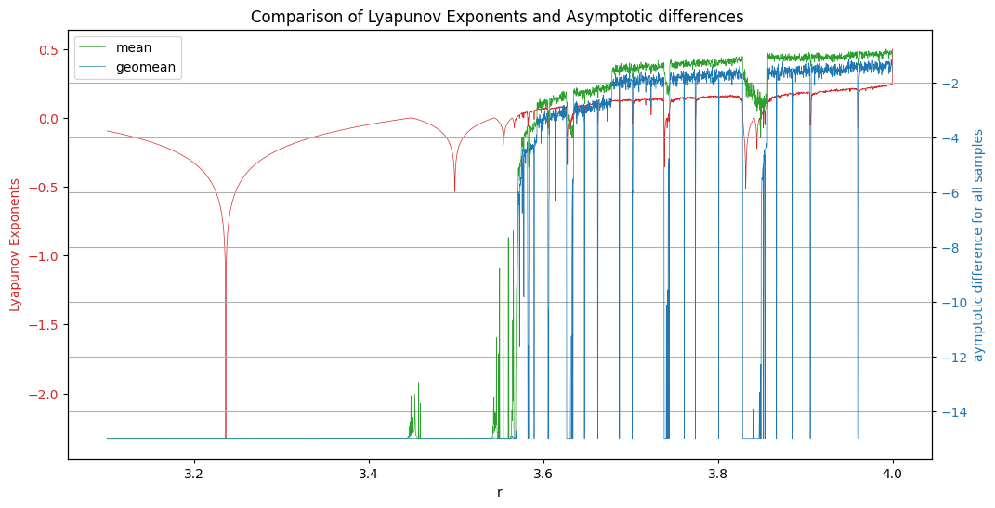

Slide 2
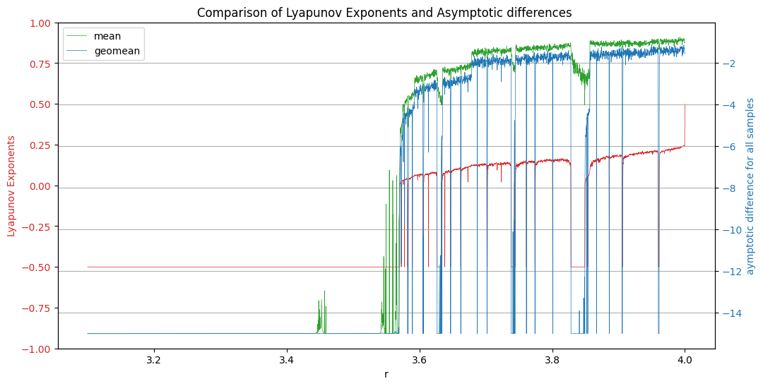
Let le<=0,become -0.5, else 1.1

Slide 3
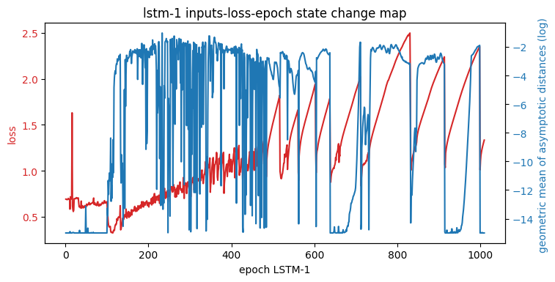
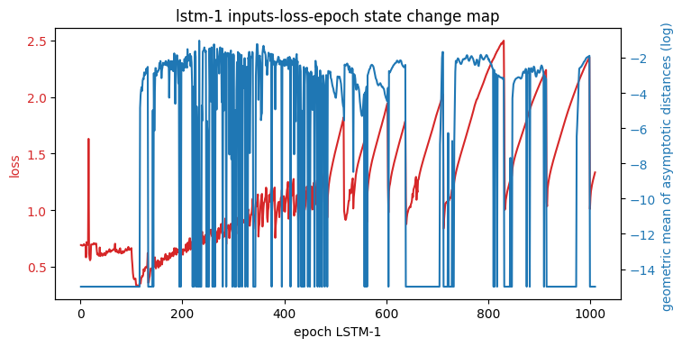
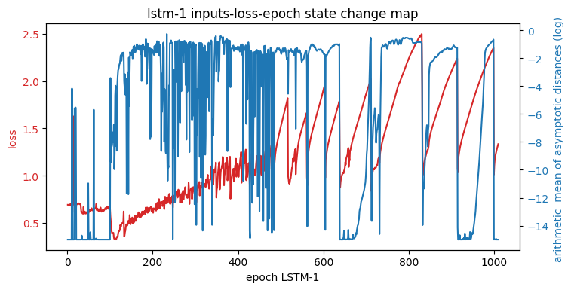

LSTM1 (gmean or arithmetical mean)
Up plots (geometric mean): left: set values<machine epsilon as 0,
right: set values<machine epsilon as exp(-15)
Down plots(mean)
Left:
set values<machine epsilon as 0,
Log(means(values))+exp(-15)
500 reviews
right:
set values<machine epsilon as exp(-15)
Log(means(values))

Slide 4
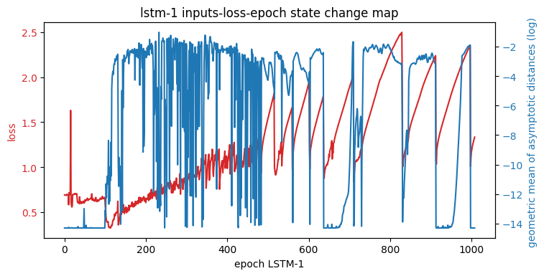
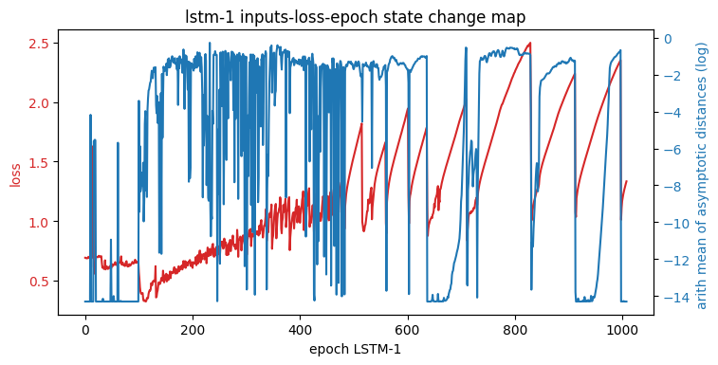
set values<machine epsilon as exp(-15)
Left: log(means(values))
set values<machine epsilon as exp(-15)
right: log(means(values)+exp(-15)

Slide 5
LSTM1 (gmean)
Slide 27 and28 : set values<machine epsilon as 0, use geomean not mean
Slide 29 and 30: set values<machine epsilon as exp(-15), use geo mean not mean

Slide 6
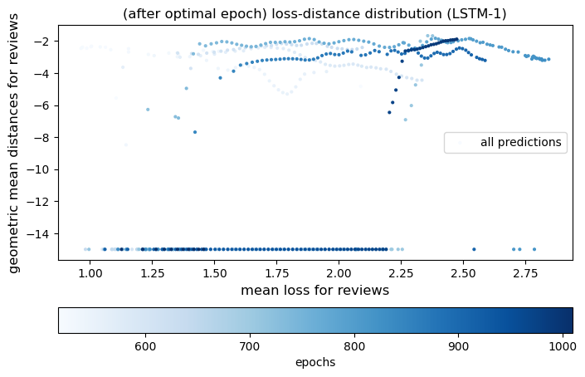
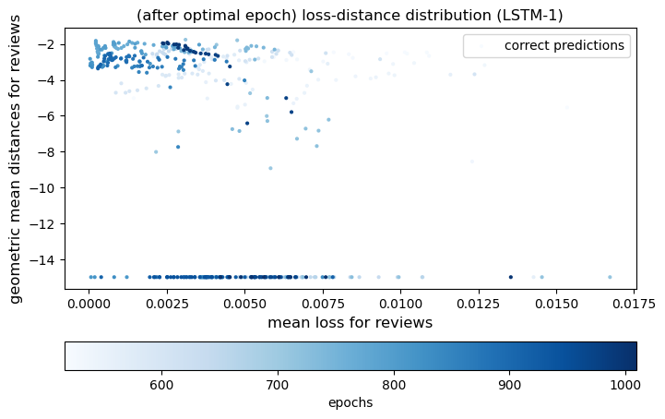
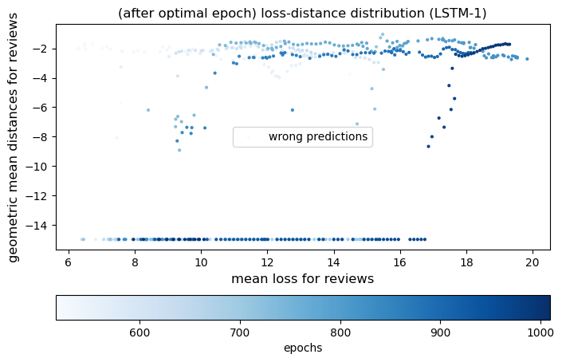

Slide 7
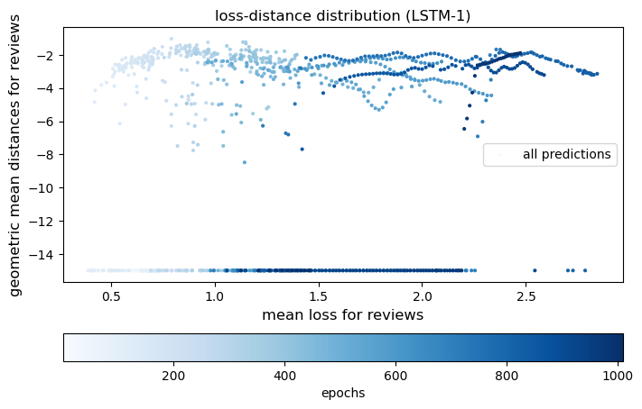
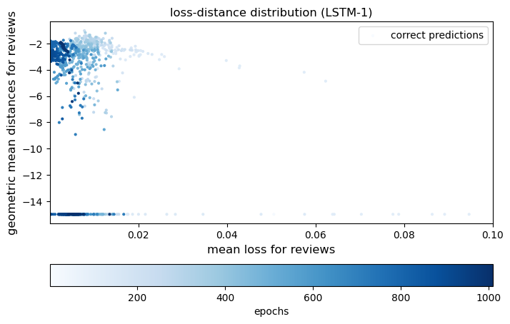
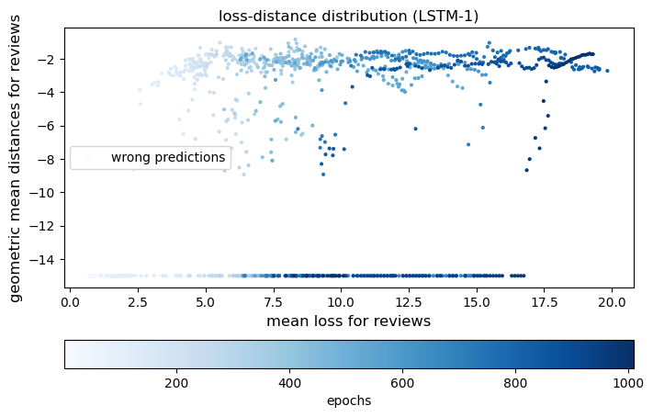

Slide 8
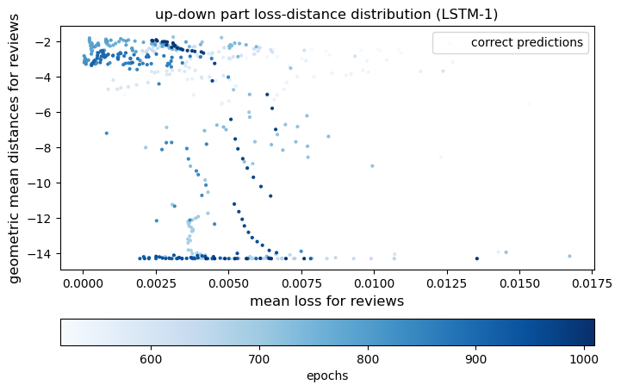
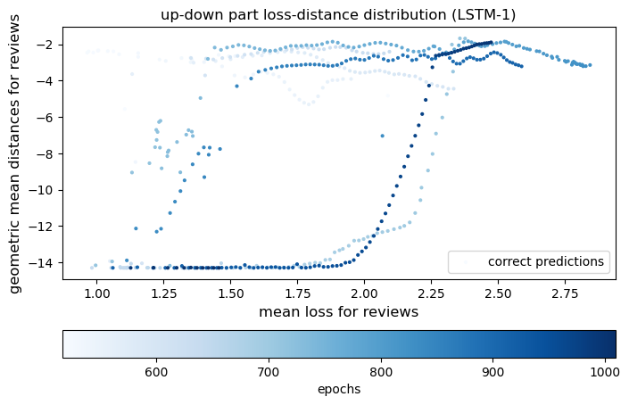
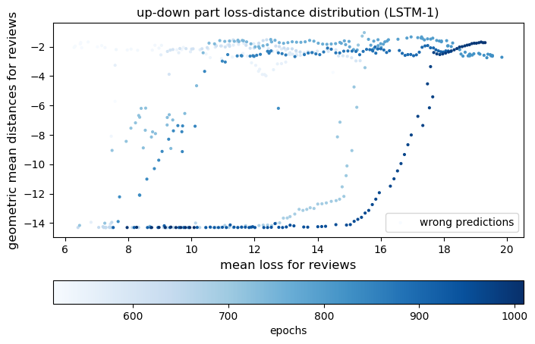

Slide 9
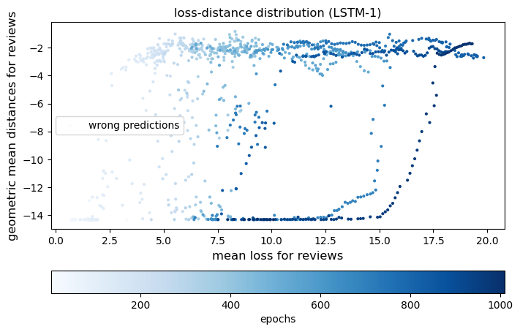
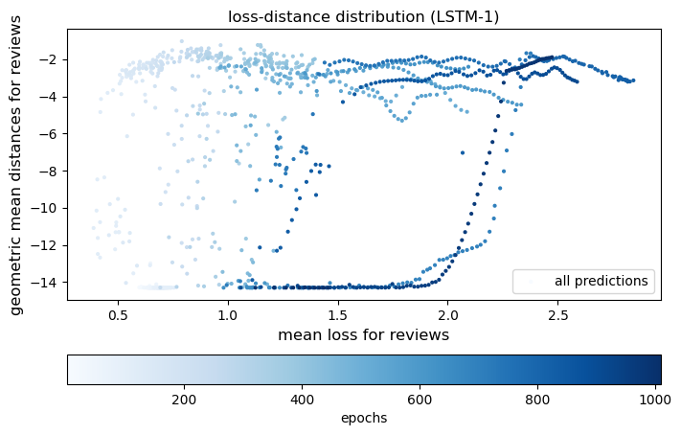
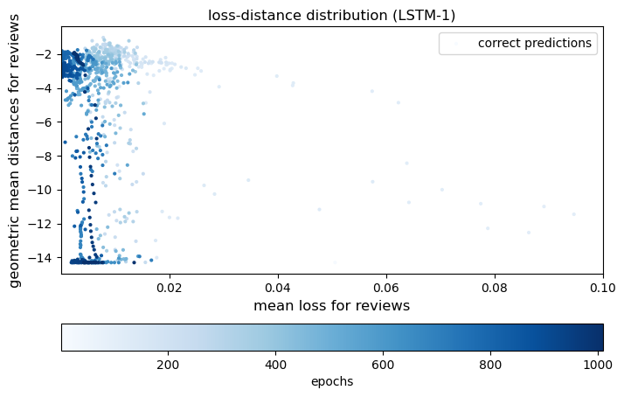

Slide 10
LSTM1 (mean)
Slide 32 and33 : set values<machine epsilon as 0, use mean

Slide 11
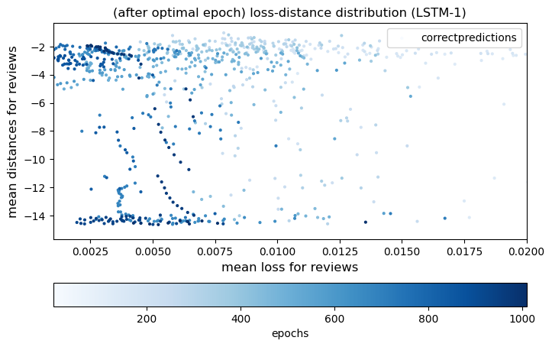
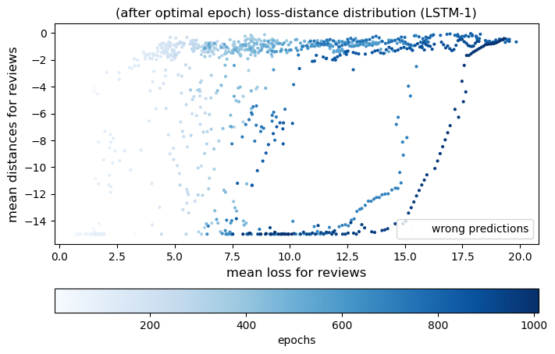
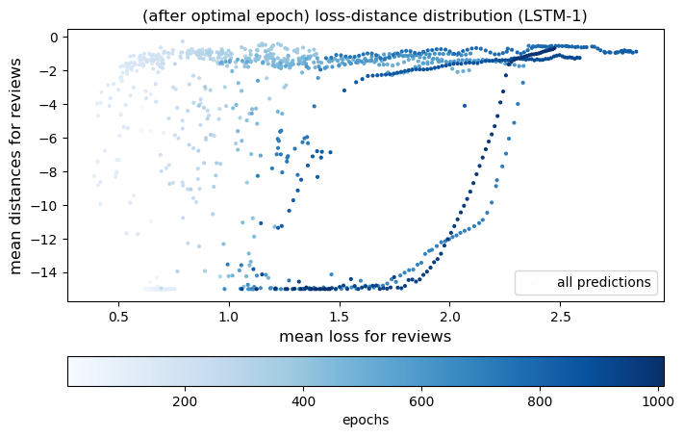
average

Slide 12
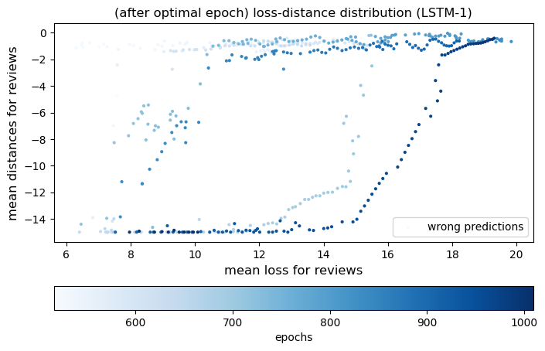
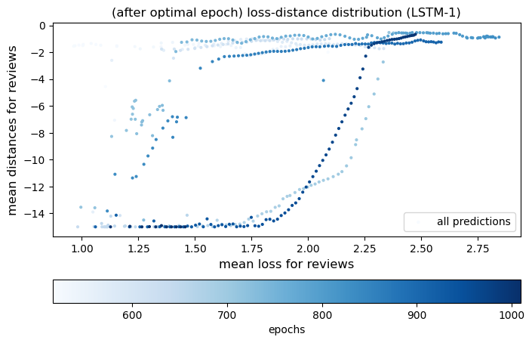
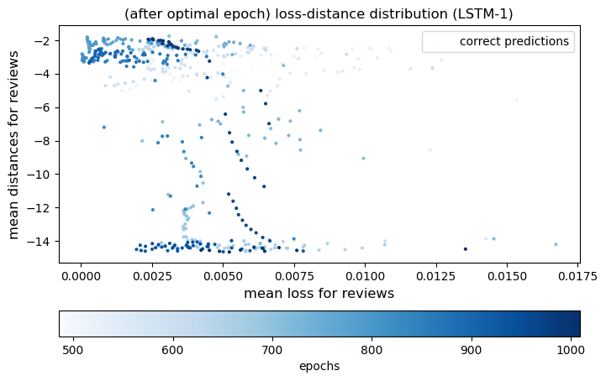

Slide 13
LSTM2 (gmean)
Slide 35: small reviews
Slide 36: 500 large samples reviews

Slide 14
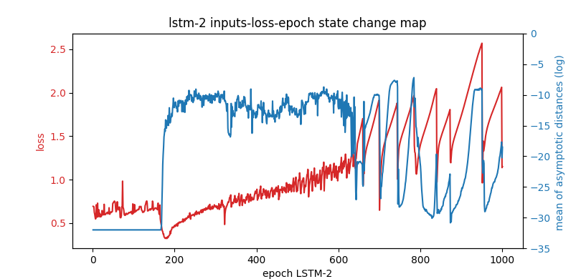
LSTM2 (50 reviews) average
Add noise in xinput

Slide 15
LSTM2 (500 reviews) average
Add noise on hiddens inputs not x input

Slide 16
LSTM2 (500 reviews) average
Add noise in hinput

Slide 17
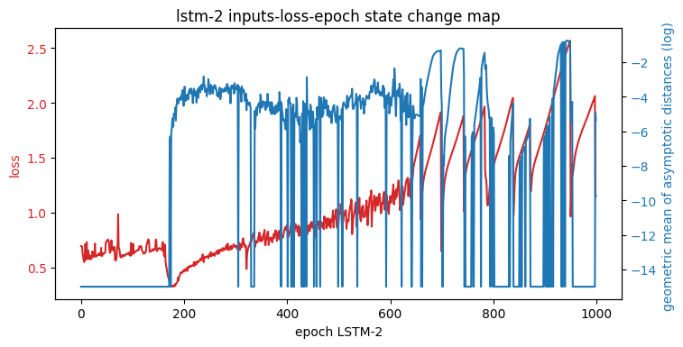
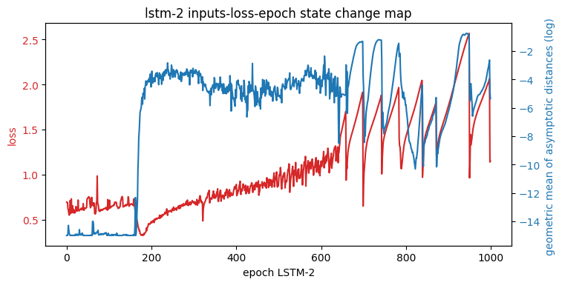
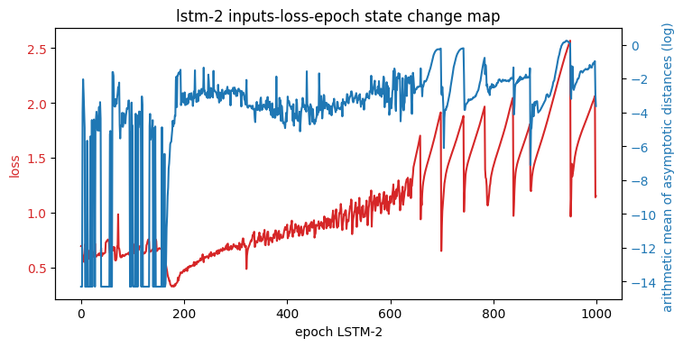

(large reviews) (gmean)
Geomean(set values <machine errors as exp(-15)
Geomean(set values <machine eroors as 0)
Geomean: shrink the pertubation of strange reviews samples
All the calculations
Log(means(values)+exp(-15))

Slide 18
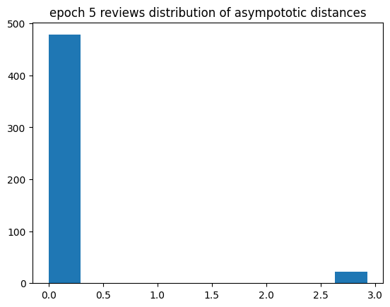
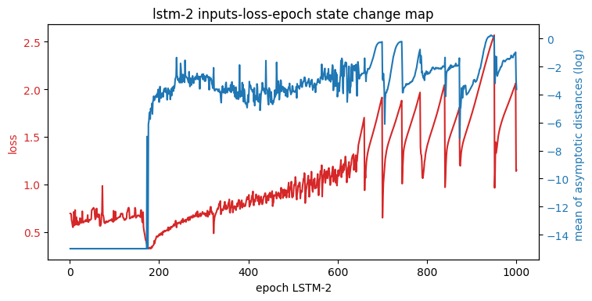
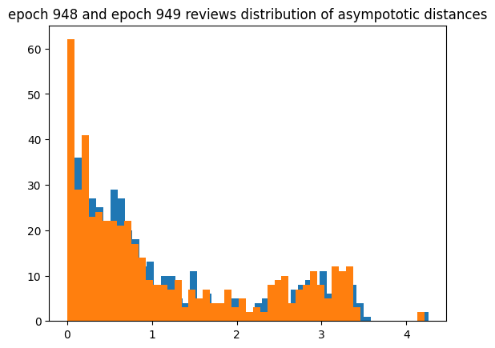
(large reviews) (gmean)
Before optimal geomean
After average
Geomean: shrink the pertubation of strange reviews samples
In this case,
Average will be better
Geo会失真，具体看4

Slide 19
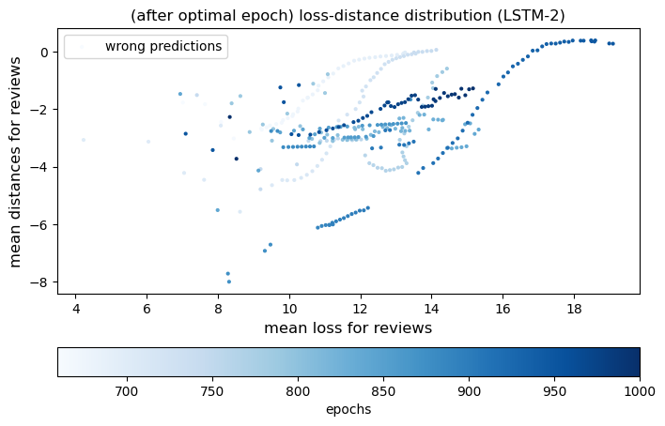
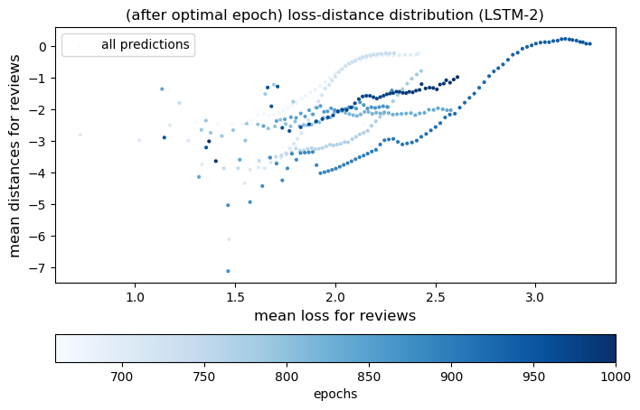
LSTM2 (average)

Slide 20
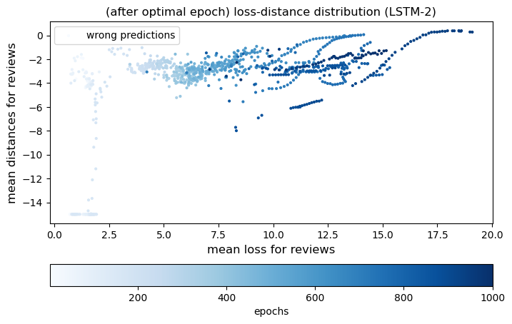
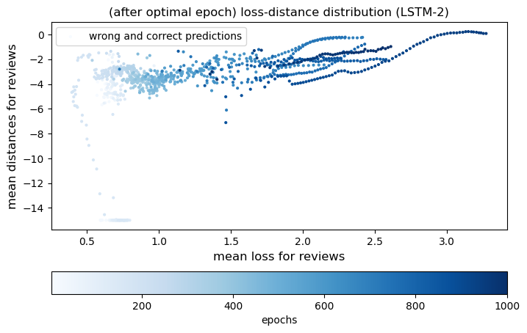
LSTM2 (average)

Slide 21
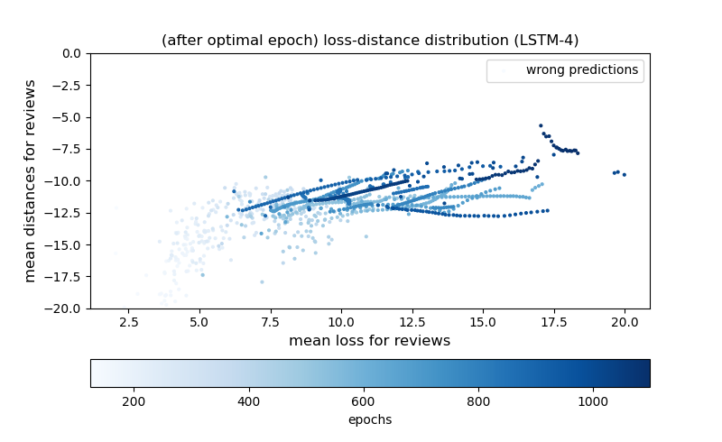
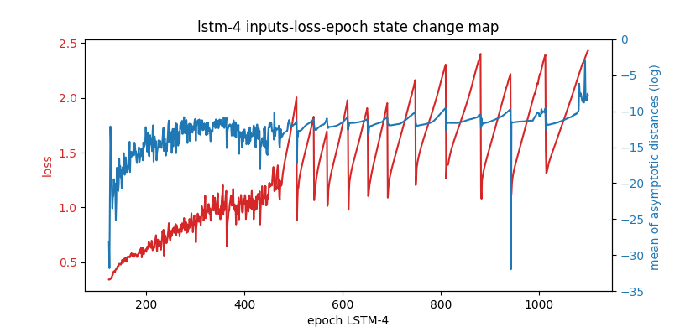
LSTM4 (add noise on xinput)
average
50 reviews
Distances:
Np.mean(Log(values))

Slide 22
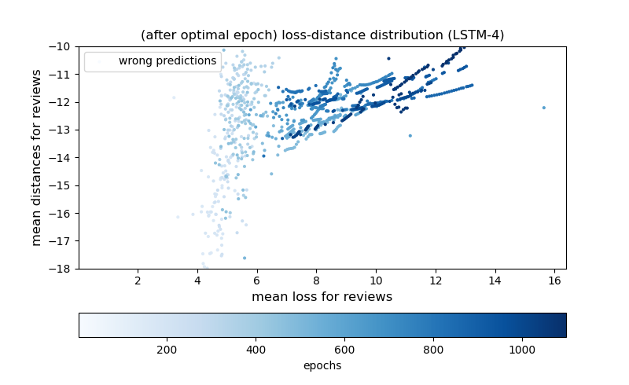
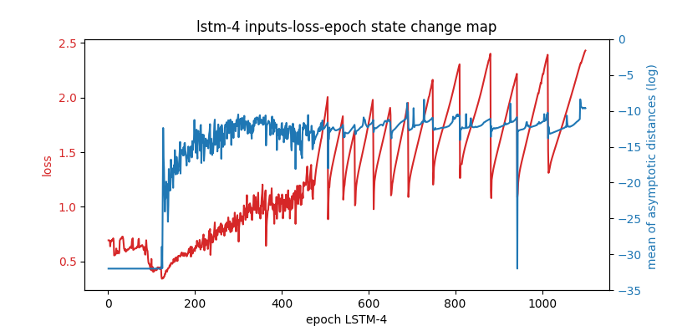
LSTM4 (add noise on xinput)
Athetical mean

Slide 23
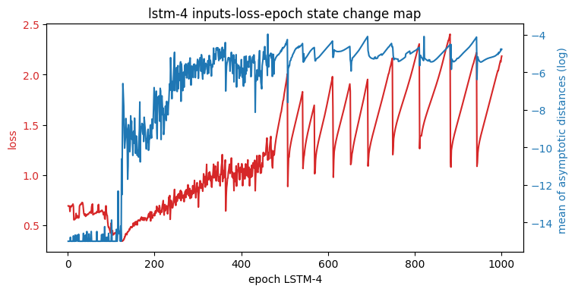
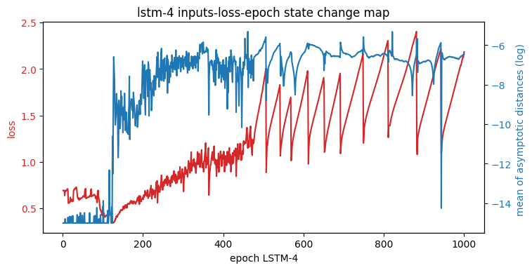
LSTM4 (add noise on hidden)
500 reviews
全部geo平均不是所有都符合 updown曲线
The first is before opt, use geomean, after use arithmetic mean
All geo mean

